Slide 1
Enriching our curriculum through the arts
Practical applications for Islamic schools

Slide 2
Creativity engages the whole brain
Scientific, mathematical, and linguistic sections of the mind
Using more of the brain leads to quieting the mind and deeper focus
Intrinsic reward is high as the student progresses through the project
Arts are linked to what we want students to achieve
Improved academic achievement and problem solving, improved connections between brain hemispheres, positive social and emotional development, sense of teamwork
No child left behind cut funding

Slide 3
ART IMPROVES MOTIVATION AND CONCENTRATION
Art activity may simulate a meditative state
The mind is in the best condition in order to receive information
Alpha brain rhythm
Relaxed state in which the brain can retain the most information

Slide 4
Music to slow the brain wavelengths
Music also will decrease the brain rhythm, silencing it to the wavelength that will be optimal for learning, especially baroque.
https://www.bing.com/videos/search?q=baroque+largo+music&&view=detail&mid=7E1B037935392D3966CE7E1B037935392D3966CE&FORM=VRDGAR

Slide 5
ART IMPROVES TEST SCORES, IMPROVES ADADEMIC ACHIEVEMENT AND PROBLEM SOLVING
The Arts Education Partnership analyzed 62 studies by about 100 researchers and compared the academic achievement and performance on standardized tests of students who have had art and those who have not.
They scored better, improved in social skills, increased motivation
"If they're worried about their test scores and want a way to get them higher, they need to give kids more arts, not less," says Tom Horne, Arizona's state superintendent of public instruction. "There's lots of evidence that kids immersed in the arts do better on their academic tests." Vega (2012)

Slide 6
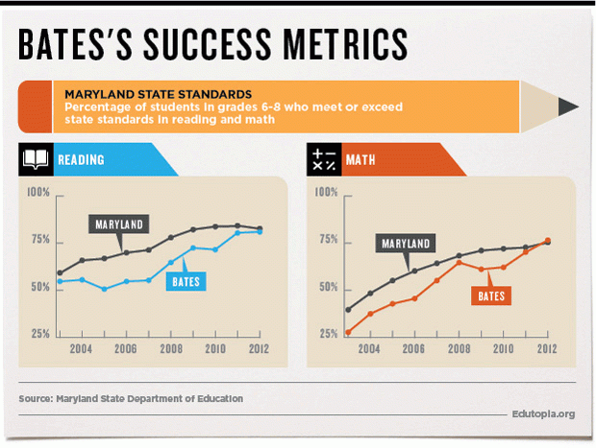
Wiley H. Bates Middle School study
Annapolis, Maryland - 4-year grant to integrate art education.
Percentage of students who achieved/surprassed standards grew from 73 percent in 2009 to 81 percent in 2012, and from 62 percent to 77 percent for math during the same period, while disciplinary problems decreased 23 percent from 2009 to 2011

Slide 7
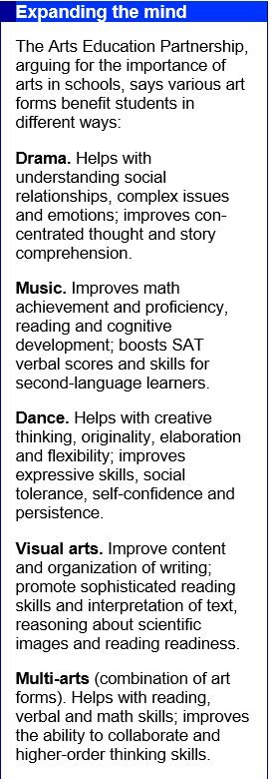
Various art forms benefit students in different ways
Drama improves social development and comprehension of stories, music helps students become more proficient in math, as well as verbal skills, dance helps with social skills as well as confidence and creativity, the visual arts improves writing, reading, and writing organization

Slide 8
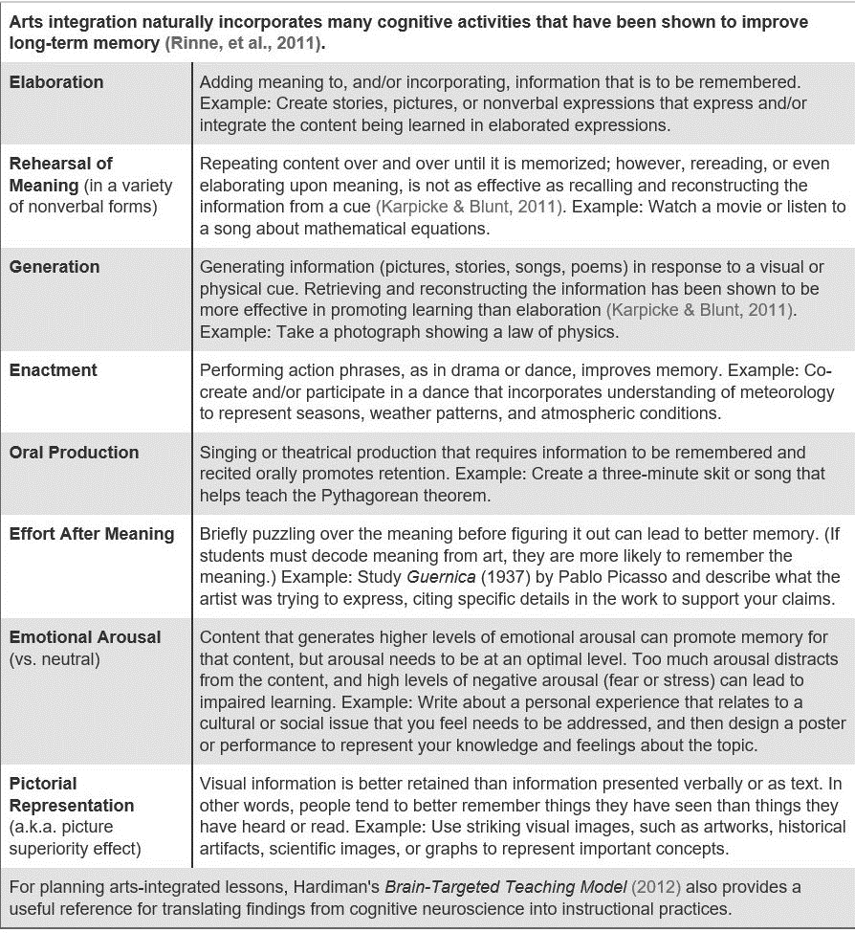

Slide 9
ART IMPROVES CONNECTIONS BETWEEN BRAIN HEMISPHERES
The neural pathways that are responsible for attention can improve intelligence levels when being engaged and focusing deeply on art
Perceiving the three-dimensional and putting it on a two-dimensional plane or looking at an object from different perspectives is a complex process that consumes the whole brain
By using the whole brain, one experiences more serenity, increased imagination, and ease of memory
When the use of the brain is balanced between the two hemispheres, the individual’s full potential can be tapped

Slide 10
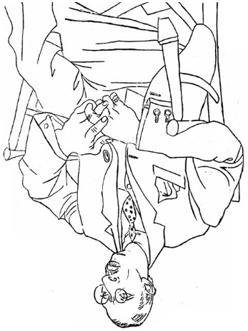
Techniques for connecting brain hemispheres
Some techniques include copying a drawing upside down, forcing the brain to analyze the relationships between the lines and see the image as a series of shapes instead of what the students are accustomed to seeing

Slide 11
ART FOSTERS POSITIVE SOCIAL AND EMOTIONAL DEVELOPMENT AS WELL AS TEAMWORK
“As children participate in art activities they gain self-confidence, feel pride in their work, and experience success.”
Art also helps students express what they may not be able to verbalize, allowing for discussion afterwards.
During group projects, students learn about diverse views, and see that when their unique ideas are meshed with others, something can be created that otherwise one person couldn’t have possibly accomplished.

Slide 12
PERFORMING ARTS IN THE CLASSROOM
offer some time and space to extemporaneous speech about what they know about a subject.
They can also write and perform a dialogue about the subject in class. They can personify math, science, or grammar terms, and he or she can act like that term and talk to other terms
while reading long passages in poetry or long monologues, break it up and assign the students to stand in different parts of the room and present their section. This can be applied to any long, mundane reading
of students can take any section of a story or history lesson and make a silent play, using only movements to demonstrate what the play or lesson is saying

Slide 13
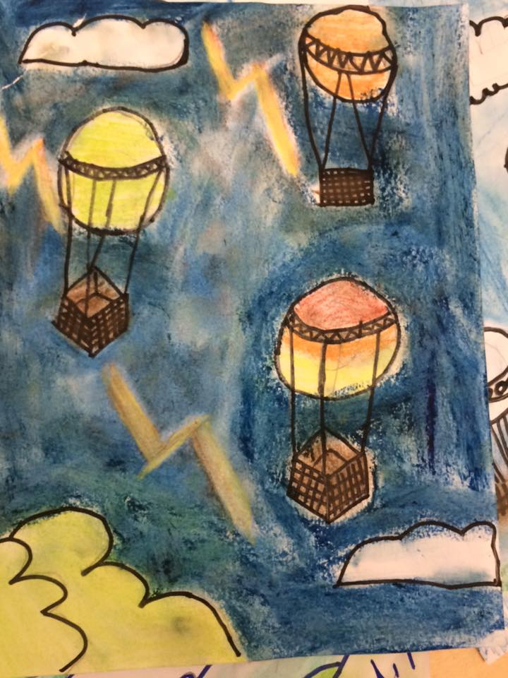
ART IDEAS FOR INTEGRATION IN K-5
Picture that references the plot of a story, atmosphere, cloud formations, or weather.

Slide 14
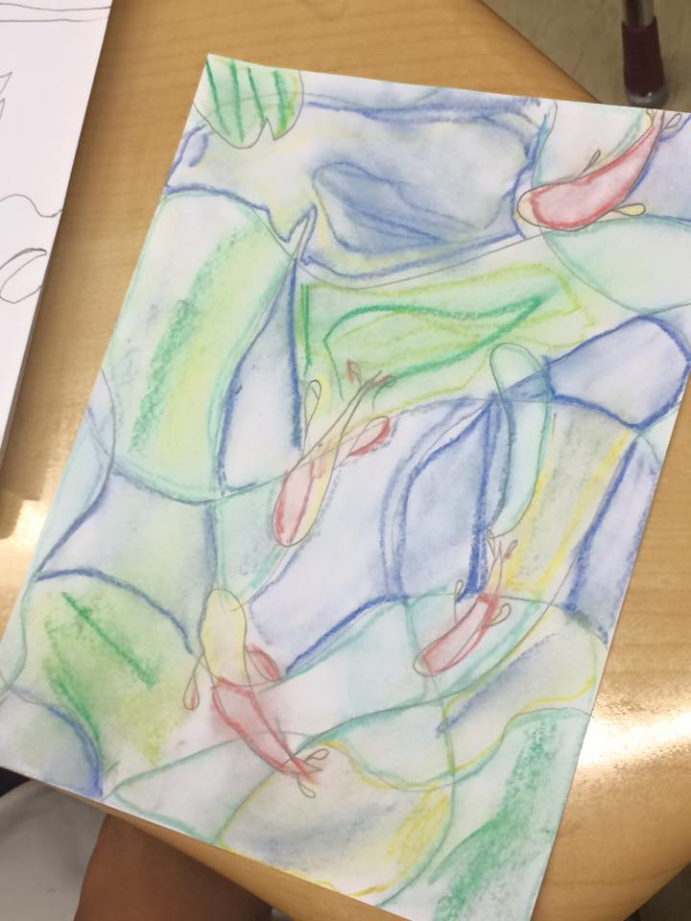
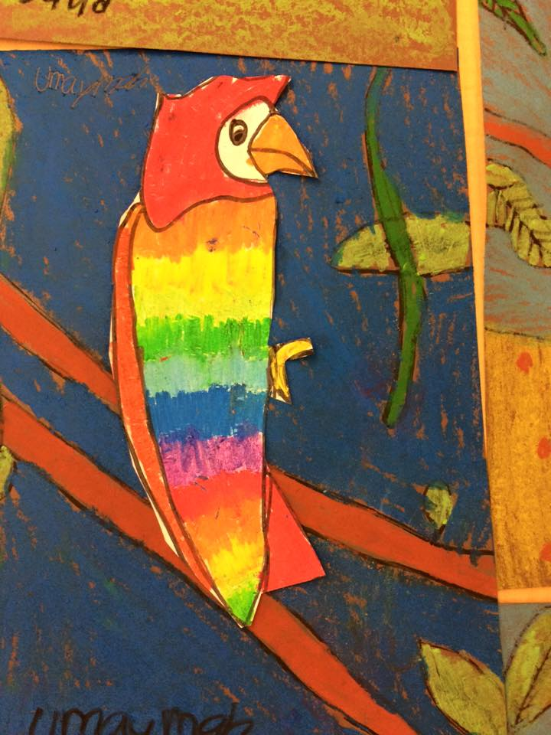
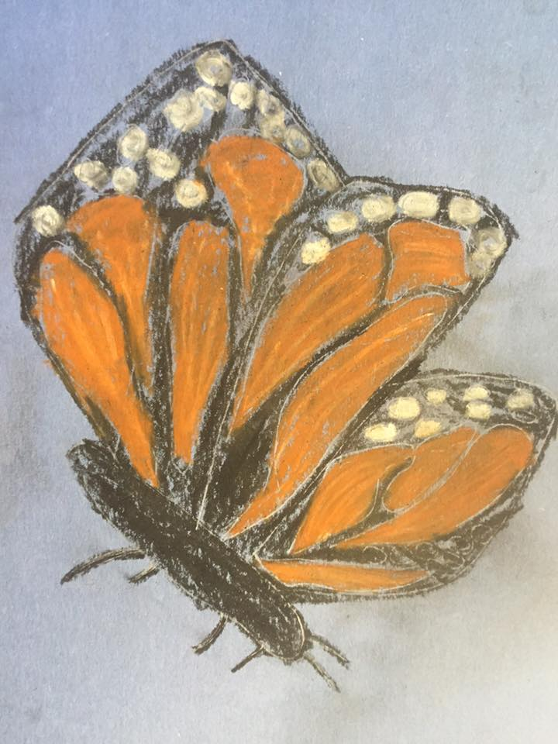
ART IDEAS FOR INTEGRATION IN K-5
Learn about the parts of insects, habitats, or flowers, oceans, and draw them using a
variety of techniques.

Slide 15
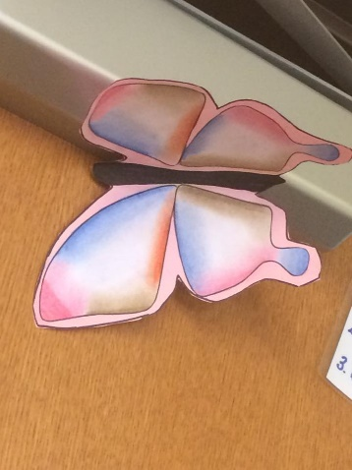
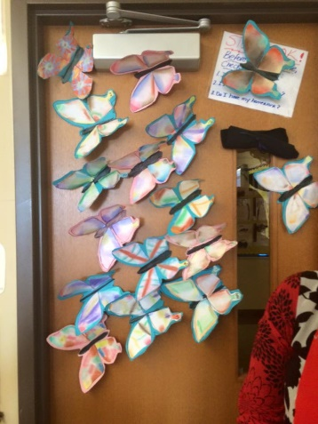
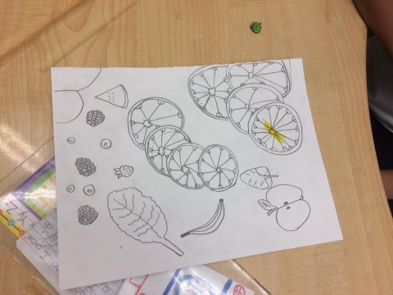
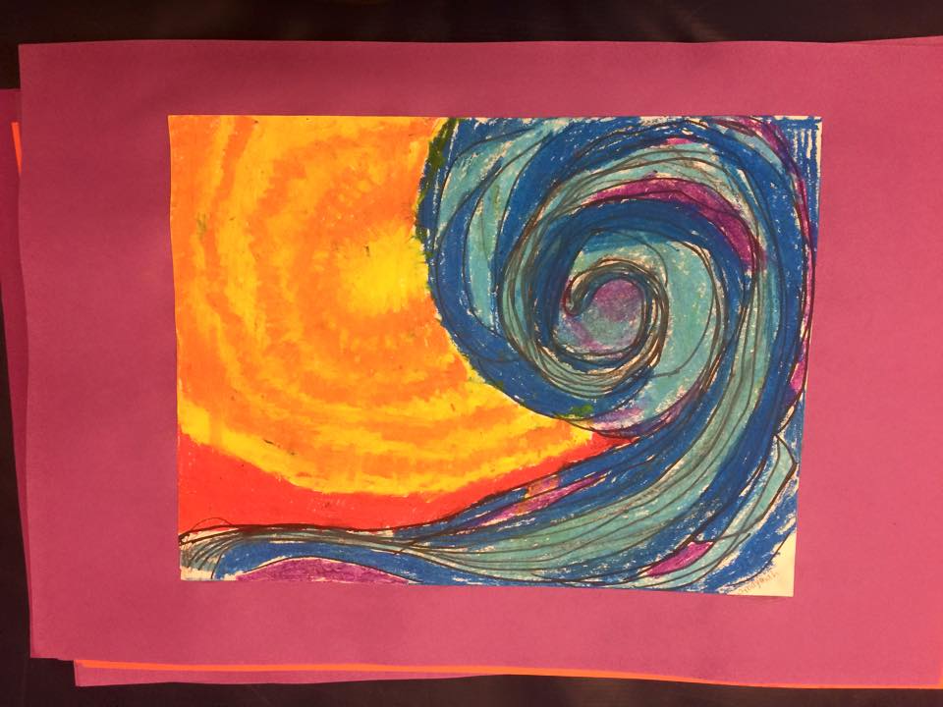
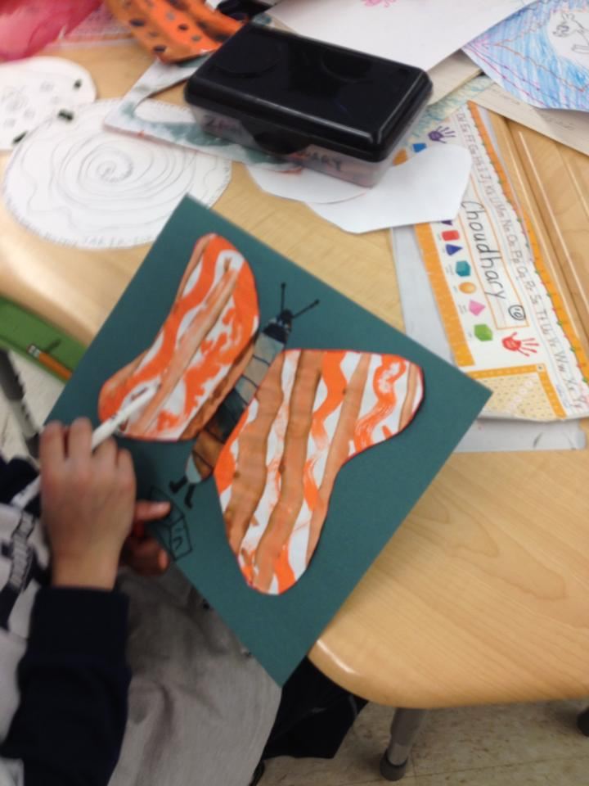
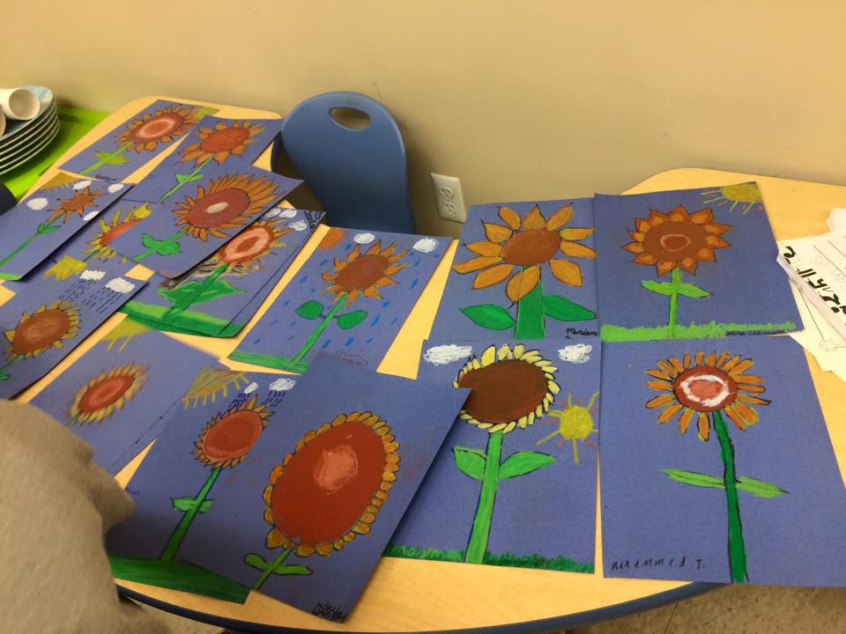
ART IDEAS FOR INTEGRATION IN K-5

Slide 16
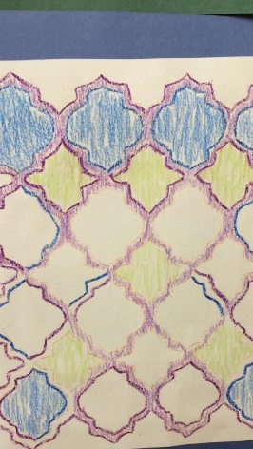
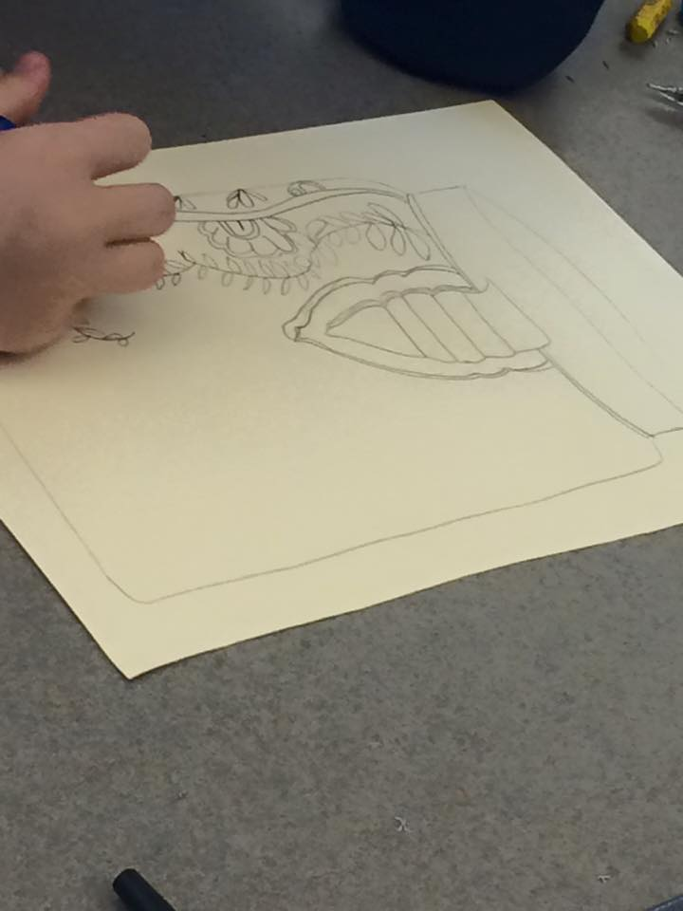
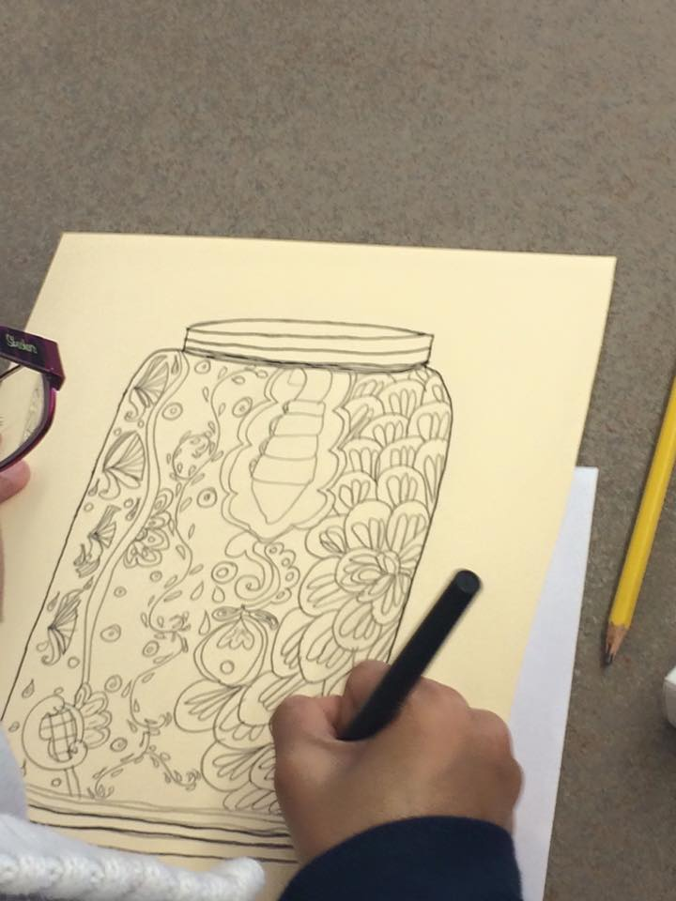
ART IDEAS FOR INTEGRATION IN K-5 – design for increased focus

Slide 17
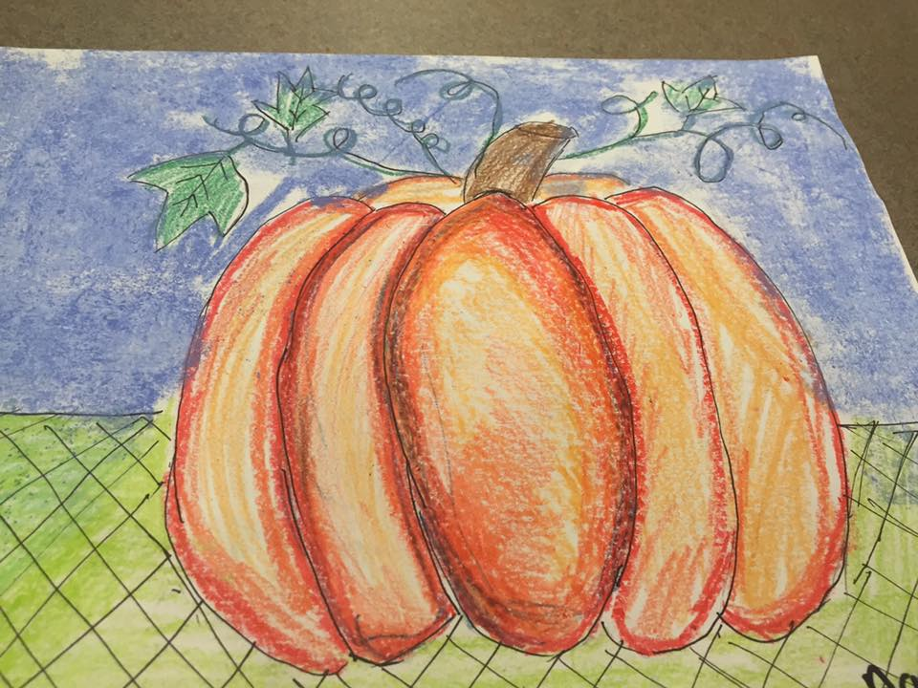
Solar system, stars, planets

Slide 18
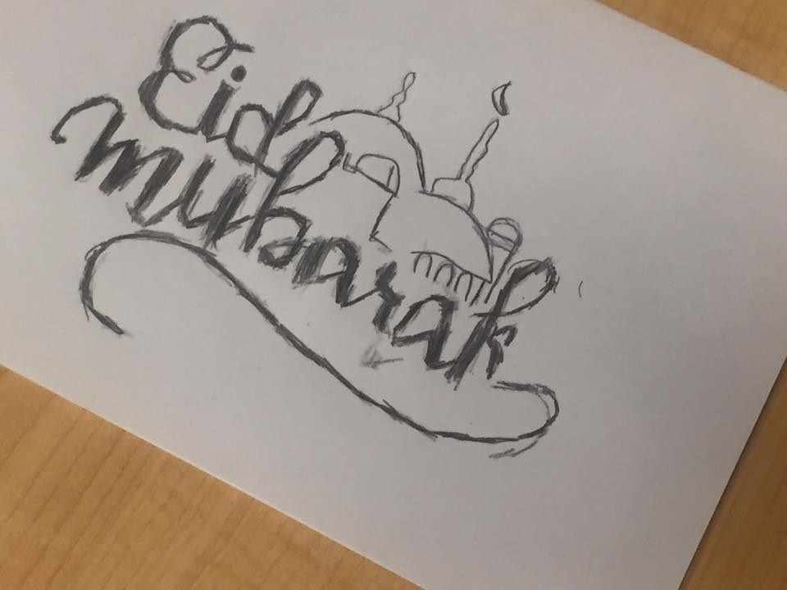
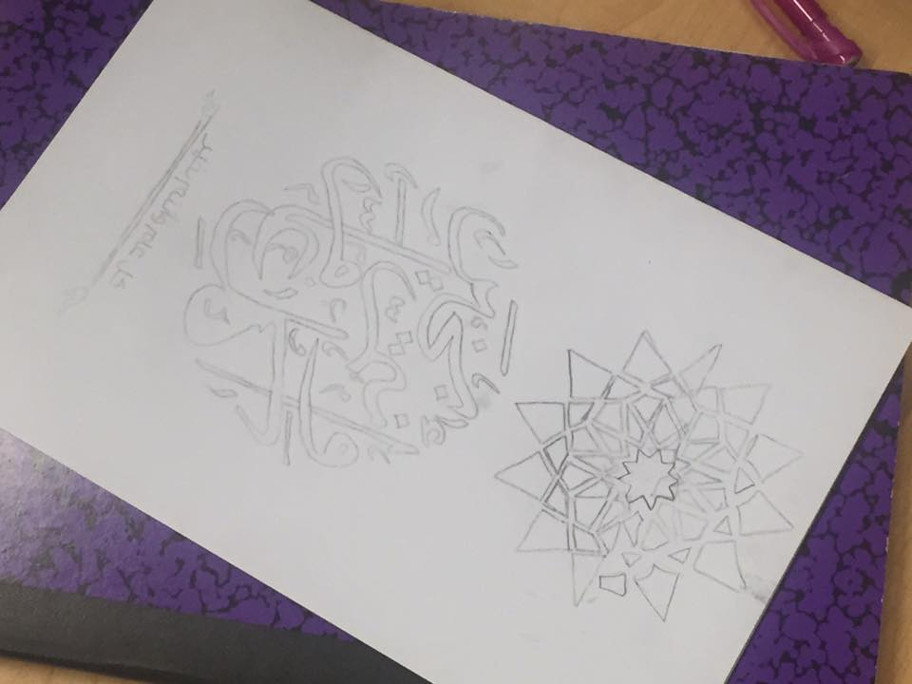
ART IDEAS FOR INTEGRATION IN 6-8
Use carbon copy technique to transfer any image to any surface.

Slide 19
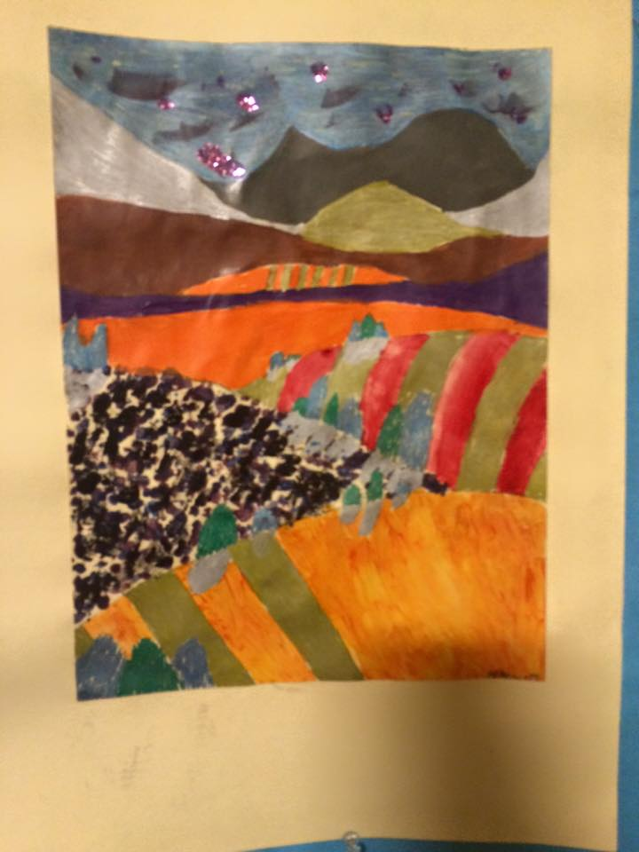
Use of expressive color to express feelings and emotions

Slide 20
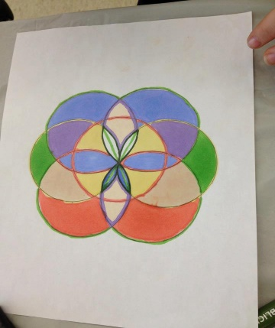
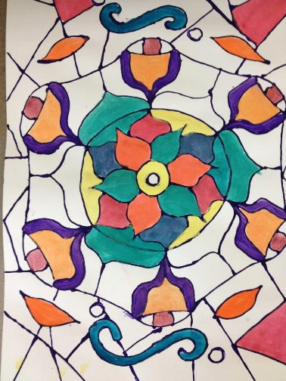
Mandalas for greater mind clarity
leads to better retention and use of skills in all subject areas

Slide 21
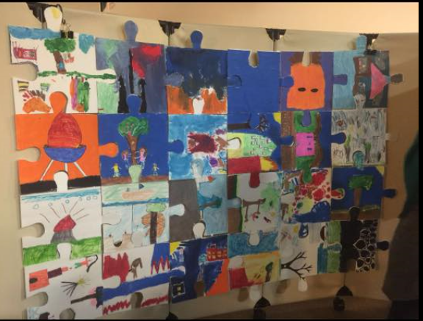
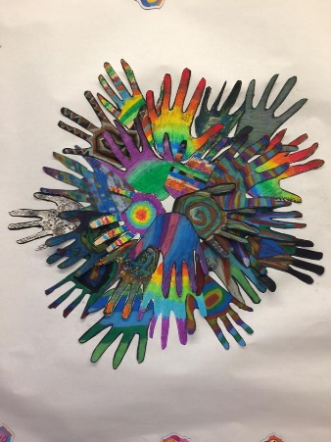
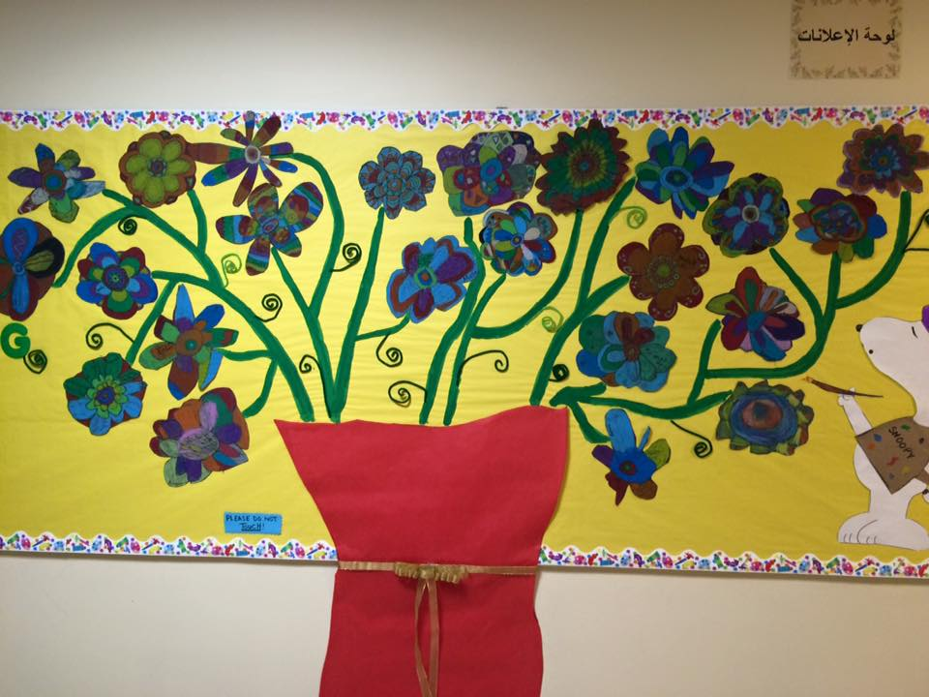
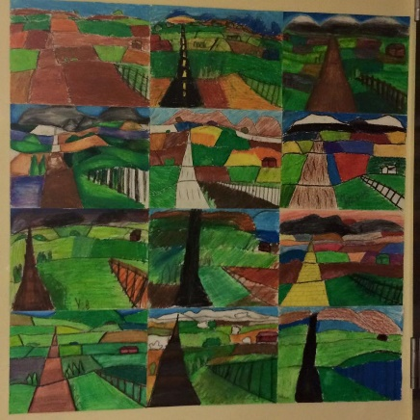
Murals for teambuilding

Slide 22
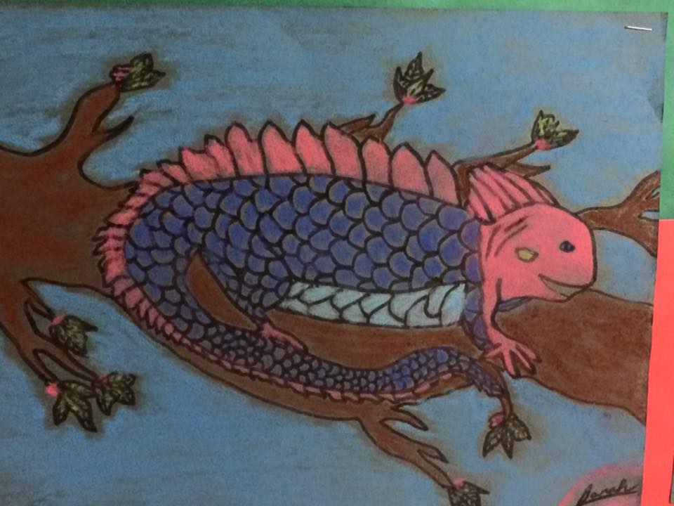
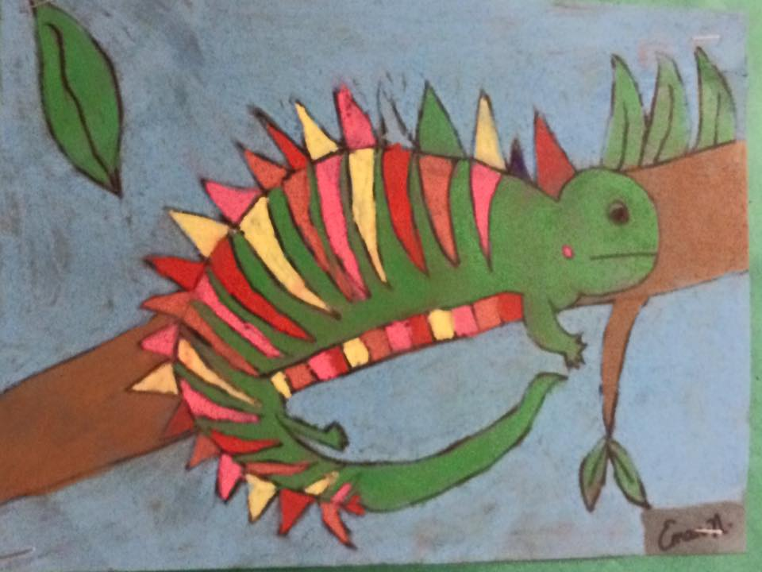
biology class, depiction of character in a book, descriptive writing

Slide 23
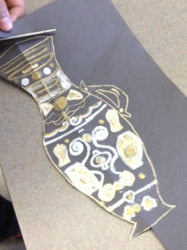
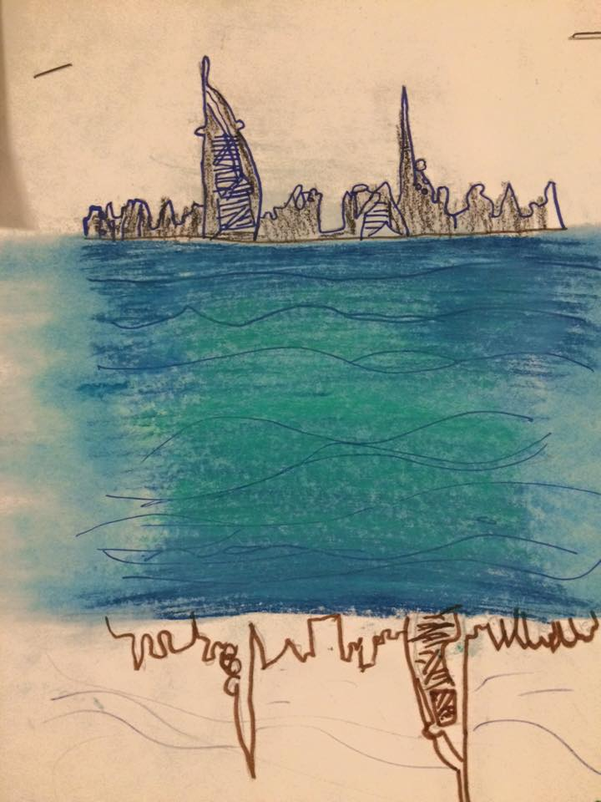
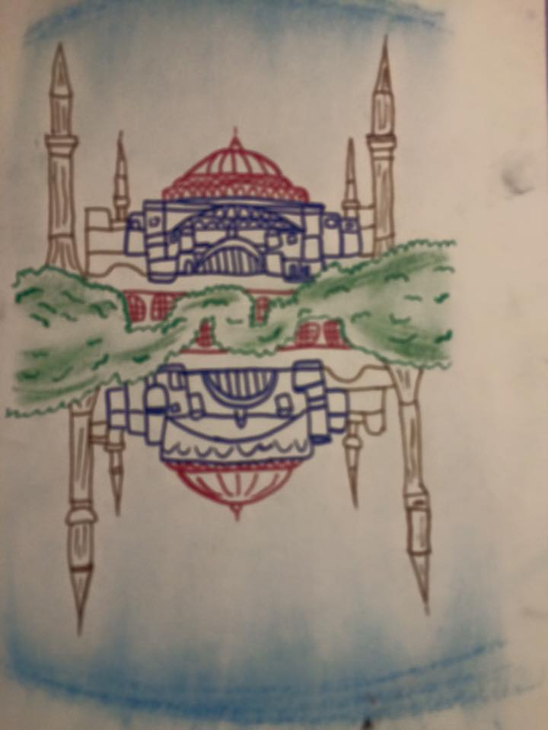
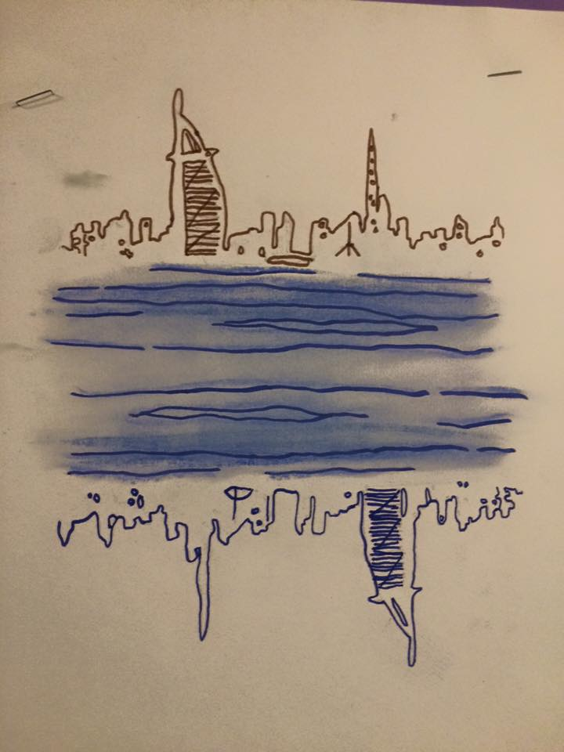
Study of different cultures, geography, religions

Slide 24
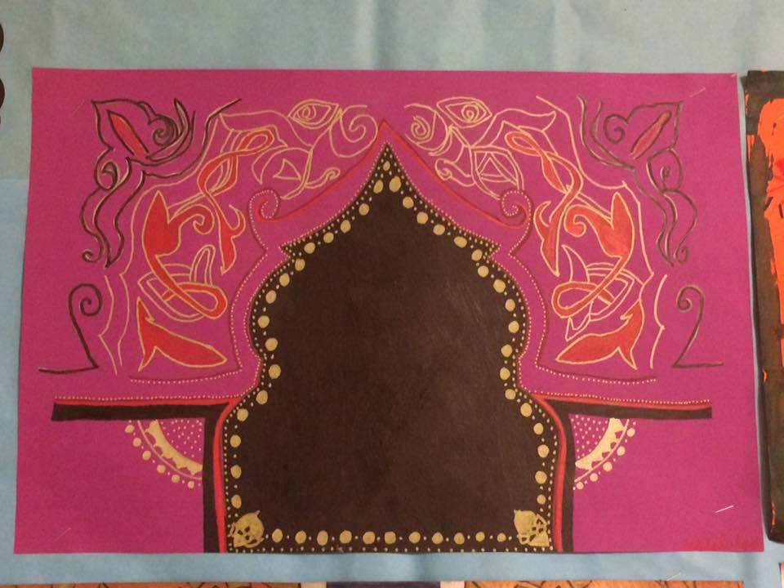
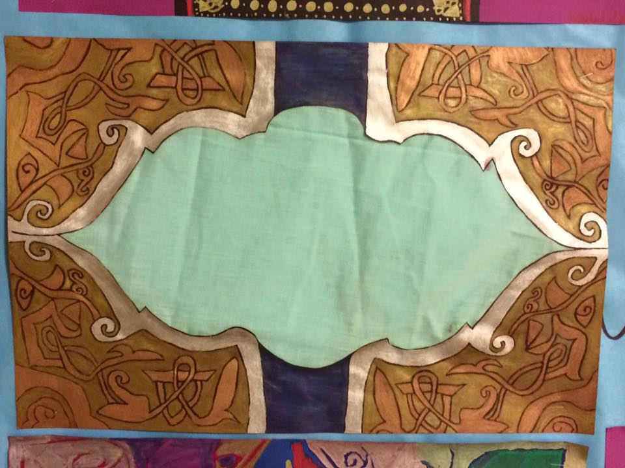
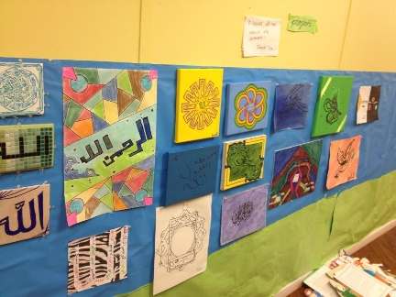
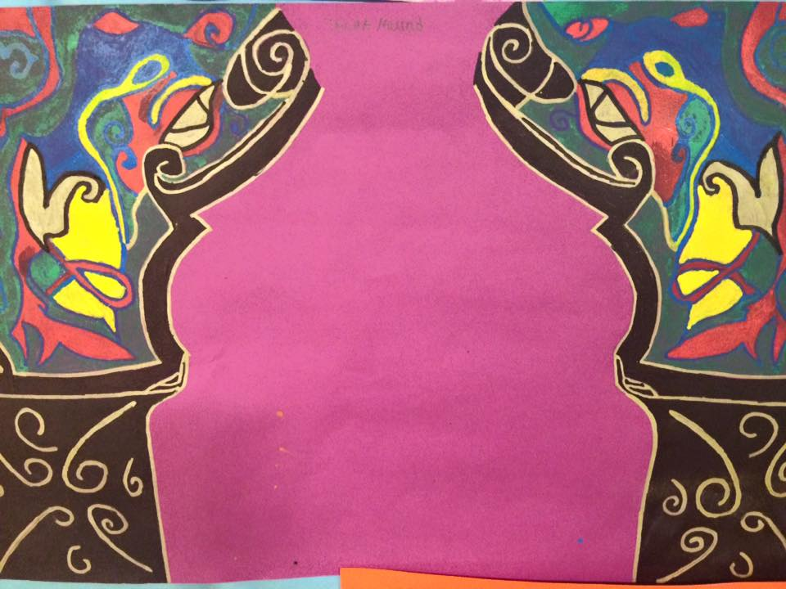
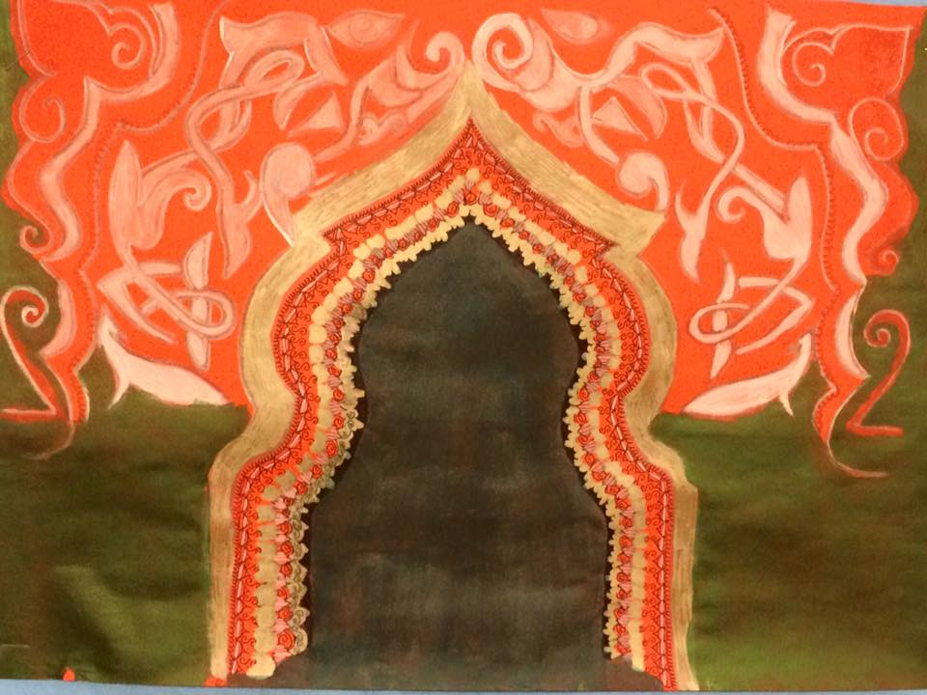
Study of different cultures, geography, religions

Slide 25
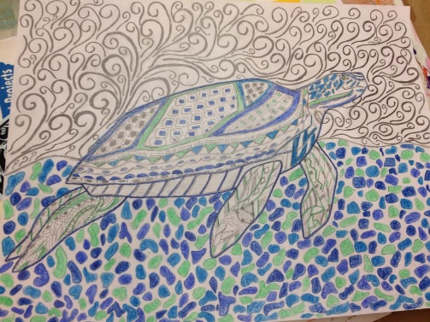
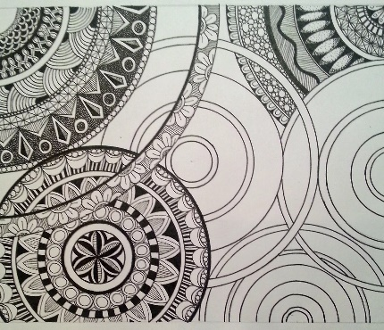
Pattern and zentangle

Slide 26
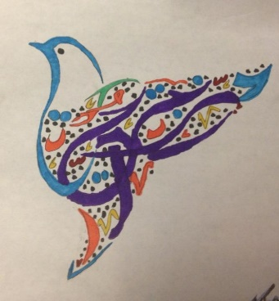
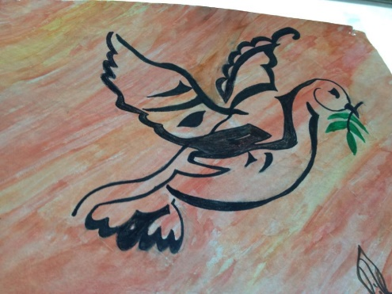
Language classes

Slide 27
graphing

Slide 28
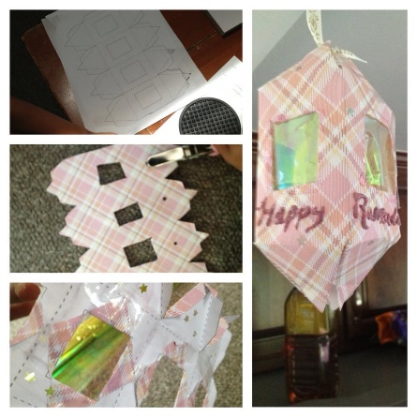
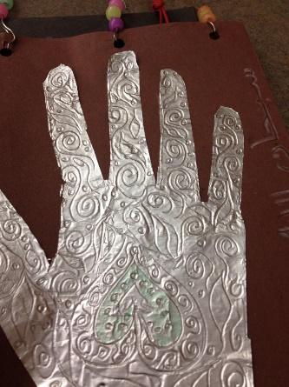
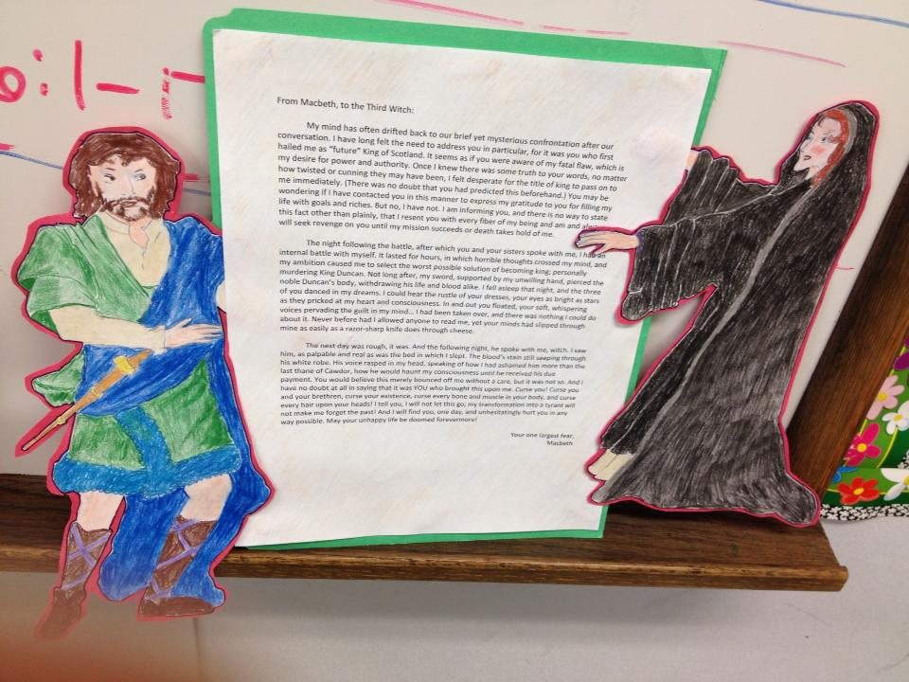
sculpture

Slide 29
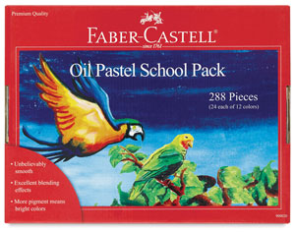
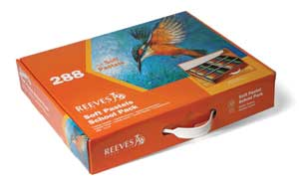
Now what? What supplies to keep in the classroom
each classroom should have good quality markers (prismacolor), some oil pastels, soft pastels, colored pencils, black sharpies, acrylic paint, watercolor, scissors and different paper

