Slide 1
Establishing an Effective Islamic School System
Systemization of School Administration
Dr. Fawzia Mai Tung

Slide 2
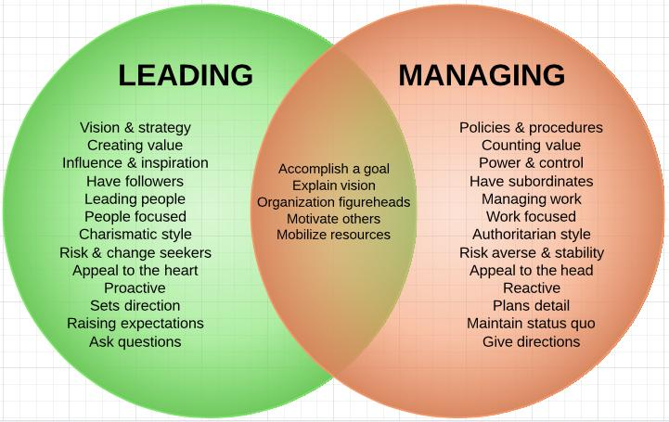
Is an Islamic School Principal…
A leader?
A manager?
Both?
Neither?

Slide 3

Management is:
… efficiency in climbing the ladder of success.

Slide 4

Leadership:
… determines whether the ladder is leaning against the right wall.
-- Stephen Covey

Slide 5

What percentage of time should you spend on:
Leadership/Management?
Depends on:
  Age of school
  Size of school
  Authority flow chart
  Culture of your organization
Try to aim for: > 50%

Slide 6
Systemization: Time and Effort

Slide 7

Steps for Setting Up Systems
Self-Evaluation: Actual Time Spent vs. Types of Activities
Establish goal: Ideal Time Spent vs Types of Activities
Identify Areas most needing Systemization → Priority
Set up tools: Operations Manual folders and documents
Copy and paste existing systems
Write systems for priority areas

Slide 8
Self-Evaluation
Jot down your activities
Journal for 1-4 weeks
Categorize activities

Slide 10
Steps for Setting Up Systems
Self-Evaluation: Actual Time Spent vs. Types of Activities
Establish goal: Ideal Time Spent vs Types of Activities
Identify Areas most needing Systemization → Priority
Set up tools: Operations Manual folders and documents
Copy and paste existing systems
Write systems for priority areas

Slide 11
Analyze the Self-Evaluation
Tally time vs category of work.
Establish goals/ideal.
Compare to goal/ideal.
Comment or question

Slide 12
Maybe combine coordination with secretarial?

Slide 13
Steps for Setting Up Systems
Self-Evaluation: Actual Time Spent vs. Types of Activities
Establish goal: Ideal Time Spent vs Types of Activities
Identify Areas most needing Systemization → Priority
Set up tools: Operations Manual folders and documents
Copy and paste existing systems
Write systems for priority areas

Slide 14
Type of activity | # of hours | % | Ideal # hrs | % | Diff’nce | Priority Areas
leadership | 30 | 13.6% | 40 | 25% | +11.4%
administration | 27 | 12.2% | 40 | 25% | +12.8%
coordination | 42 | 19% | 20 | 12.5% | -6.5% | #2
secretarial | 18 | 8.1% | 4 | 2.5% | -5.6% | #3
Event management | 30 | 13.6% | 4 | 2.5% | -11.1% | #1
Discipline | 8 | 5.8% | 1 | 0.6% | -5.2%
Instruction | 40 | 18.1% | 40 | 25% | +6.9%
PR | 9 | 4% | 8 | 5% | +1%
Janitorial | 10 | 4.5% | 0 | 0% | -4.5% | #4
Nursing | 6 | 2.7% | 3 | 1.8% | -0.9%
Total | 220 |  | 160

Slide 15
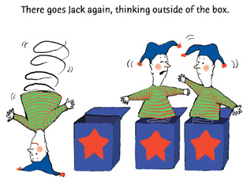
Analyze the Priority Areas
Event Management: -11.1%
Coordination: -6.5%
Secretarial: -5.6%
Janitorial: -4.5%
Delegate?
Systemize?
Hire? Contract?
Think outside the box?

Slide 16
Steps for Setting Up Systems
Self-Evaluation: Actual Time Spent vs. Types of Activities
Establish goal: Ideal Time Spent vs Types of Activities
Identify Areas most needing Systemization → Priority
Set up tools: Operations Manual folders and documents
Copy and paste existing systems
Write systems for priority areas

Slide 17
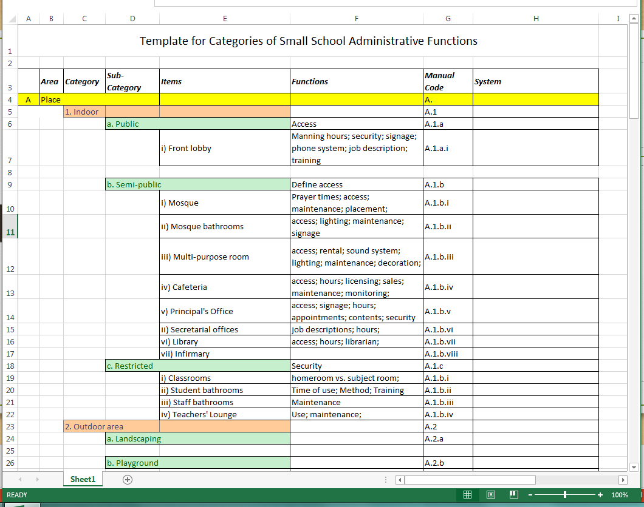
Set up a coded Table of Content

Slide 18
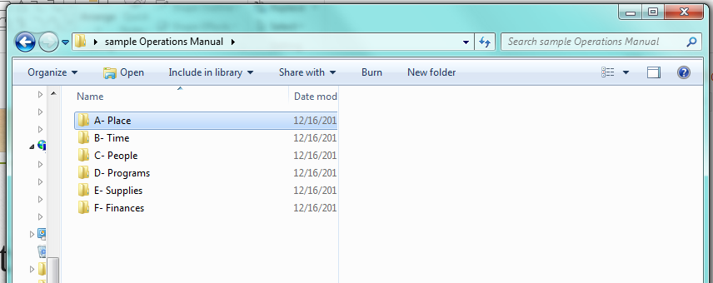
Set up Operations Manual Folder

Slide 19
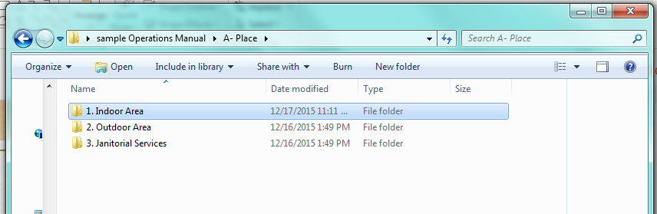
And Sub-Folders

Slide 20
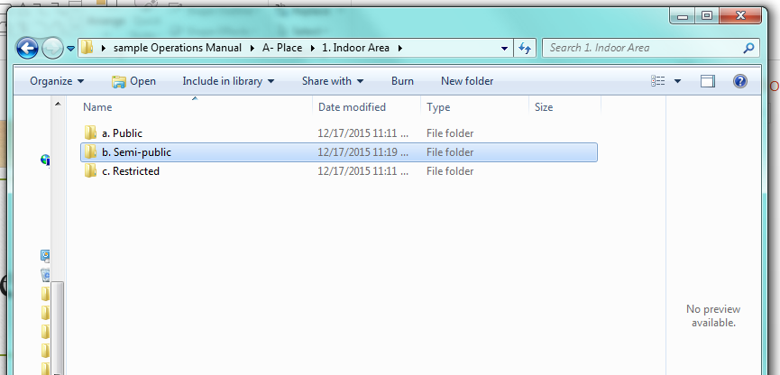
And Categories Folders

Slide 21
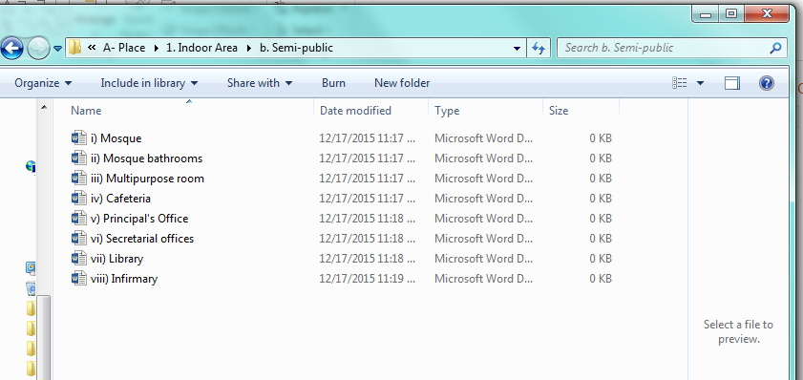
… containing items documents

Slide 22
Sample document: Fire Drill
D.4.a: Fire Drill
Last updated: 12/10/15
The person in charge of the fire drill is the Facilities Manager.
The Facilities Manager will map out the evacuation routes (See attached maps) and display the evacuation maps on the wall closest to the exit door of every single room in the buildings.
The Principal will train all staff on their fire drill duties during the staff orientation each year prior to the start of school. Namely, to herd the students quietly, in a single file, with each student holding the shirt of the student in front of him. The target is to complete evacuation in less than three minutes.
The Principal will assign various sections of the building/s to various members of the administrative staff. Each is to walk through his/her assigned section to check that all students have been evacuated, especially the bathrooms.
The Homeroom Teachers will train all students on their evacuation routes and assembly point during the Student Orientation Day at the start of each school year. All Homeroom Teachers must take a roll call and record the number of students present at the Assembly Point.
The Facilities Manager will mark on the school calendar, no later than two weeks prior to the start of the school year, and after the yearly calendar has been finalized by the principal, the planned dates of the monthly fire drills.
On the date of the fire drill, the Facilities Manager will notify the principal of the drill in the morning, at the start of the school day.

Slide 23
Fire Drill (continued)
The principal reserves the right to change said date depending on events and availability.
The Facilities Manager will call the closest fire station to notify them of the drill, five minutes prior to the start of the drill.
The Facilities Manager will then notify administrative staff of the impending drill.
The Facilities Manager pulls the fire alarm, and starts the timer.
All teachers evacuate their classes as trained.
The Principal and the administrative staff will “sweep” their assigned sections to ensure all students and staff have left the buildings.
All assemble in neat lines in the parking lot. The Principal takes the reports of student numbers from each Homeroom Teacher, while the Facilities Manager records the time taken for each class to arrive and line up.
A quick feedback is taken to ensure the drill proceeded successfully and smoothly.
All students are dismissed in turn and led back to class by their teachers.”

Slide 24
Overkill? Or Too Vague?
Details on person responsible is NOT overkill.
Details on items impossible to check or control IS overkill.
Too Vague:
  When reader does not know what to do.

Slide 25
Example 2: Marketing Event
D.2.c: Marketing Event
Last Updated: 2/25/11
Process Flow
  (Person X) identifies potential marketing event/ date and time.
  (Person X) notifies Principal.
  (Approval Meeting): Principal meets with Person X and Marketing Team, weighs pros and cons;

Slide 26
Marketing Event: State each person’s job
At this time, Marketing Team consists of:
  Head of Marketing: John Smith
  Marketing Coordinator: Abraham Lincoln
  Marketing Representative (contracted): Jane Doe
  Other persons as needed, may include Person X

Slide 27
Marketing Event: Team work
Marketing Team then:
  a) Approves event unanimously. Otherwise rejects proposal.
  b) Assigns a $ amount (not including materials under General Marketing materials)
c) Decides on person responsible and methods of payment for:
i) Booking (location)
    ii) Various expenses
    iii) Customer payments

Slide 28
Marketing Event:
Goals and Criteria for Success
Head of Marketing takes lead on project, meets with marketing team.
At Initial Meeting, the following are decided:
Goals for event (example: increase visibility of school)
Criteria for measurement of success (example: 50 sign-ups for school e-newsletter)
Design of event participation
Job assignments, including main liaison with event organizer
Need for extra workers

Slide 29
Feedback and Future Planning
Need for performers
$ amount to be allocated to each category
Marketing Team holds regular update meetings to report to one another on progress.
Marketing Head keeps Principal updated on a weekly basis at Staff Meetings.
After event, Marketing Team holds feedback meeting. Feedback includes report on the criteria indicating success or not of event.
Marketing Head reports to Principal at next Staff Meeting.
Principal considers and decides whether to repeat event annually.

Slide 30

Sharing the Systems
Print out Operations Manual annually (and date it).
Go over it at Staff Orientation.
Also make all forms/ handouts available electronically and/or on paper.
Always refer to the OM and use it as a yardstick esp. at meetings.
Set up some kind of feedback system and consequence system.

Slide 31

Testing the Systems
Regularly, after implementing any part of it.
Ad hoc, after emergency situations.

Slide 32
Emergency Situation: Example
You have a centralized schedule.
You are performing on schedule.
An emergency situation arises.
How do you handle it?

Slide 33
Your schedule for today:
1 | 7:30-8:00 am | Student arrivals. Morning assembly
2 | 8:00-8:30 am | Checking email, phone messages
3 | 8:30-9:00 am | Classroom round
4 | 9:00-10:00 am | Meeting with parents of xxx for discipline issue
5 | 10:00 – 10:30 am | Phone conference with ABC.
6 | 10:30 – 12:30 pm | Lunch meeting with Private School Association
7 | 12:30 – 1:00 pm | Meet with Secretary: update schedule. Dhuhr prayer.
8 | 1:00 – 2:00 pm | Work with accountant on this month’s expenses
9 | 2:00 – 3:00 pm | Social Studies teacher: monthly one-on-one
10 | 3:00 – 3:30 pm | Prepare agenda for staff meeting
11 | 3:30 – 4:00 pm | Afternoon assembly. See students off.
12 | 4:00 – 4:30 pm | Wind up work.

Slide 34
Emergency situation:
However, at 10:15 am, a student knocks on your door
and tells you that the boys’ bathroom down the hall has got tons of toilet paper in it, plus poop and a lot of mess on the floor.
The secretary/ administrative assistant/ front desk lady is on the phone.
All teachers are busy.
The janitor comes twice a week, and that is not today.
What to do?

Slide 35
Knee-jerk Reflex
Putting on gloves and getting down to business.
If you do that, then:
  shorten your phone conference → unfinished → reschedule
  Miss lunch meeting. (If you had to deliver a speech there, then the problem is even worse. )
How could all this have been averted?

Slide 36
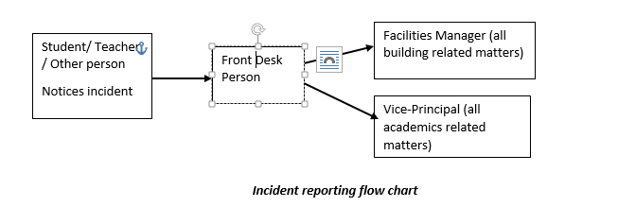
Emergency Incident Reporting

Slide 37
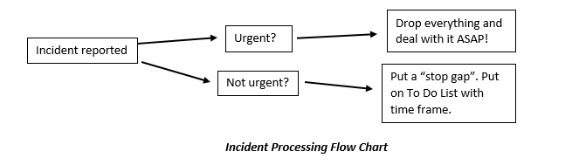
Emergency Incident Processing

Slide 38
Flow Charts Ownership
All flow charts must be shared at orientations:
  Staff
  Students
  Other relevant stakeholders
All stakeholders are held accountable.

Slide 39
Feedback and Planning (again)
After emergency situation taken care of:
  Feedback
  Planning
  If new steps:
    Incorporate into system (Operations Manual)

Slide 40

Updating the Systems
During school summer break
Incorporate all notes from Update Folder.
Update your paper copy.

Slide 41
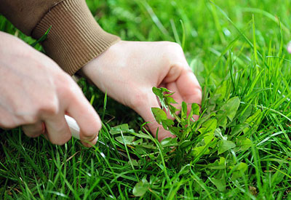
Annual Weeding and Reseeding
Attention:
  Do not let weeds grow!
  Walk through every growing section for relevance.
Remove redundant sections or items not applicable any more.
  Save them in “extra” folder in case of re-use
Add new sections as needed

Slide 42

Celebrate
Celebrate at end of year staff meeting/party.
Celebrate after successful handling of emergency situations.
Celebrate after successful implementation of regular event.
How?
  Words/ gestures
  Symbols
  Paper
  Gifts/ event/

Slide 43

Conclusion
Creating a sustainable system for your school:
  Is a great achievement!!!!
  Is the deed of a great leader.
  Will establish a foundation for growth and expansion.
  Free your time (as a principal) for leadership.
Remember to share with your board!

